Slide 1
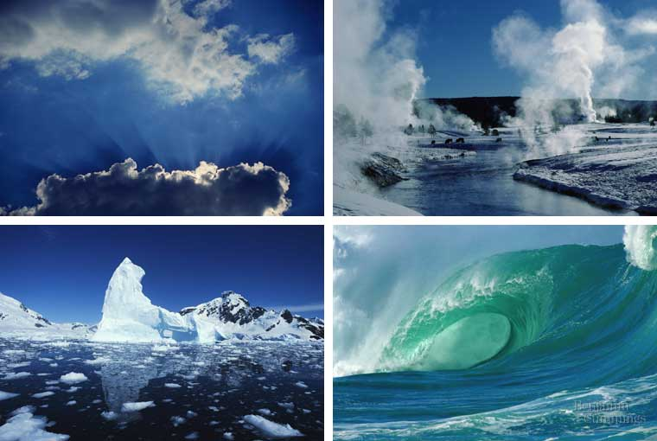
Properties of Water

Slide 2
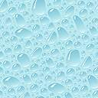
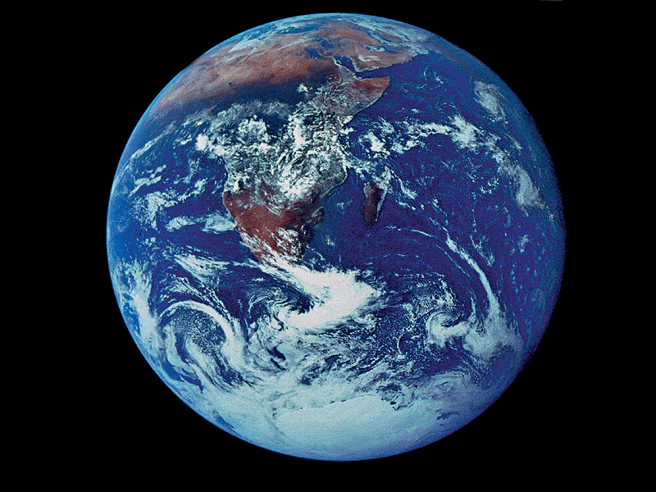
Properties of Water
Polarity
Cohesion
Adhesion
Surface Tension
Specific Heat
Density
Universal solvent
Salinity
PropertiesProperties of Water Video
Notes:
‹#›

Slide 3
Polarity of Water
A water molecule is a molecule with opposite ends of having opposite charges.
In a water molecule two hydrogen atoms form single polar covalent bonds with an oxygen atom.
Because oxygen is more electronegative, the region around oxygen has a partial negative charge.
The region near the two hydrogen atoms has a partial positive charge.
Gives water more structure than other liquids
Polarity Video
Notes:
‹#›
2 corners are orbitals with unshared electrons and a weak negative charge
2 are occupied by hydrogen atoms that have polar covalent bonds

Slide 4
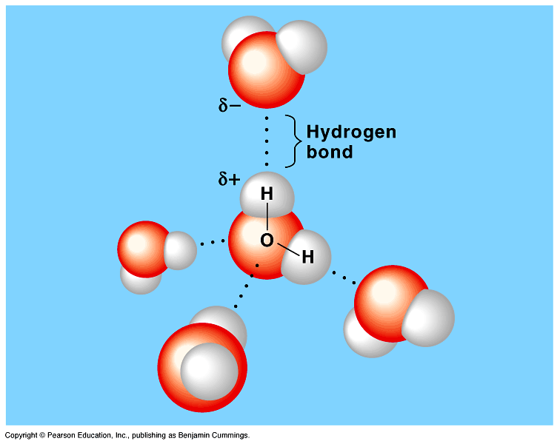
Water has a variety of unusual properties because of attractions between these polar molecules.
The slightly negative regions of one molecule are attracted to the slightly positive regions of nearby molecules, forming a hydrogen bond.
Each water molecule can form hydrogen bonds with up to four neighbors.

Slide 5
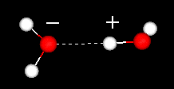
HYDROGEN BONDS
Hold water molecules together
Each water molecule can form a maximum of 4 hydrogen bonds
The hydrogen bonds joining water molecules are weak, about 1/20th as strong as covalent bonds.
They form, break, and reform with great frequency
Extraordinary Properties that are a result of hydrogen bonds.
Cohesive behavior
Resists changes in temperature
High heat of vaporization
Expands when it freezes
Versatile solvent

Slide 6
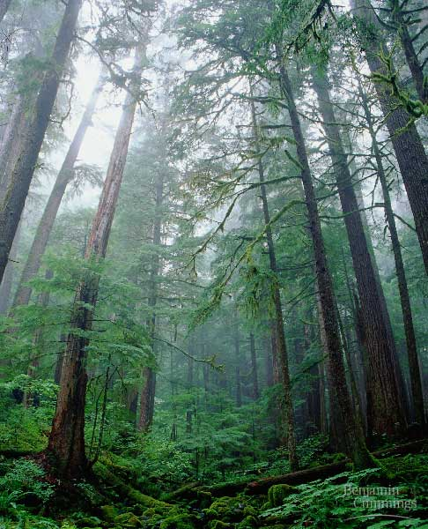
Organisms Depend on Cohesion
The clinging together of particles of the same substance, a phenomenon called cohesion
Cohesion is responsible for the transport of the water column in plants
Cohesion among water molecules plays a key role in the transport of water against gravity in plants
Adhesion, clinging of one substance to another, contributes too, as water adheres to the wall of the vessels.

Slide 7
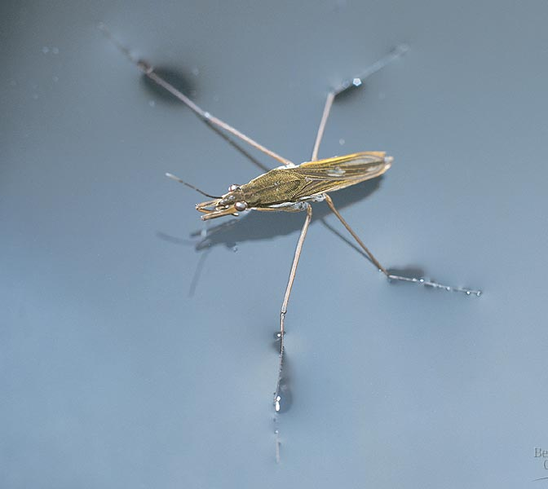
Surface tension, a measure of the force necessary to stretch or break the surface of a liquid, is related to cohesion.
Water has a greater surface tension than most other liquids because hydrogen bonds among surface water molecules resist stretching or breaking the surface.
Water behaves as if covered by an invisible film.
Some animals can stand, walk, or run on water without breaking the surface.

Slide 8
Moderate Temperatures on Earth
Water stabilizes air temperatures by absorbing heat from warmer air and releasing heat to cooler air.
Water can absorb or release relatively large amounts of heat with only a slight change in its own temperature.
Celsius Scale
at Sea Level
Fahrenheit Scale
at Sea Level
100ºC
Water boils
212ºF
Water boils
37ºC
Human body temperature
98.6ºF
Human body temperature
23ºC
Room temperature
70ºF
Room temperature
0ºC
Water freezes
32ºF
Water freezes

Slide 9
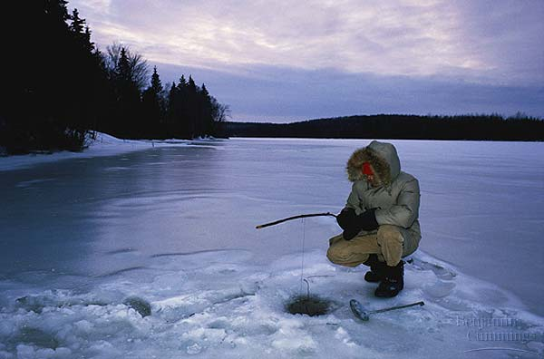
Specific Heat is the amount of heat that must be absorbed or lost for one gram of a substance to change its temperature by 1ºC.
Three-fourths of the earth is covered by water. The water serves as a large heat sink responsible for:
Prevention of temperature fluctuations that are outside the range suitable for life.
Coastal areas having a mild climate
A stable marine environment

Slide 10
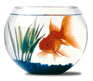
Evaporative Cooling
The cooling of a surface occurs when the liquid evaporates
This is responsible for:
Moderating earth’s climate
Stabilizes temperature in aquatic ecosystems
Preventing organisms from overheating

Slide 11
Density of Water
Density, is also known as "specific gravity".
The mass per unit volume of a substance.
As long as an object is made up of molecules, and thus has size, it has a density.
Density is just the weight for a chosen amount (volume) of the material.
The density of water at room temperature is 1 gram/cm³

Slide 12
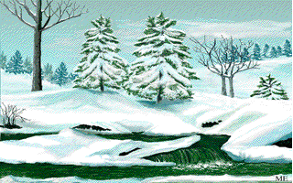
Density of Water
Most dense at 4ºC
Contracts (shrinks) until 4ºC
Expands (grows) from 4ºC to 0ºC
The density of water:
Prevents water from freezing from the bottom up.
Ice forms on the surface first—the freezing of the water releases heat to the water below creating insulation.
Makes transition between season less abrupt.

Slide 13
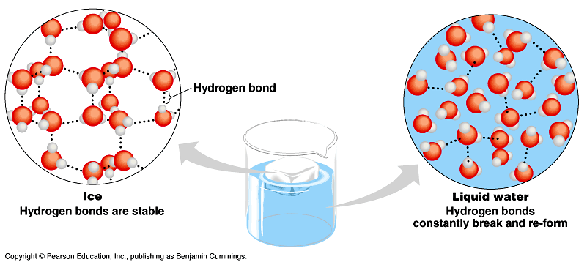
When water reaches 0ºC, water becomes locked into a crystalline lattice with each molecule bonded to to the maximum of four partners.
As ice starts to melt, some of the hydrogen bonds break and some water molecules can slip closer together than they can while in the ice state.
Ice is about 10% less dense than water at 4ºC.

Slide 14
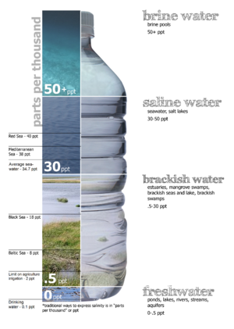
Solvent for Life
Universal Solvent
capable of dissolving all substances
Solution
Solute
Substance dissolved
Solvent
Substance dissolving
Salinity
saltiness or dissolved salt content of a body of water

Slide 15
Earth’s Water
The Earth is a water planet
70% of the Earth’s surface is covered in water
All living things are composed of 50% or more water
All living things need water to survive
The Hydrosphere is all of the water found on, above, or below the Earth’s surface

Slide 16
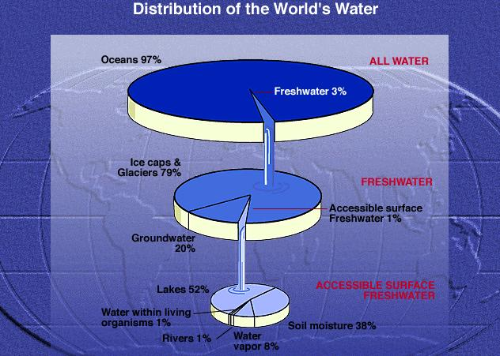
The Hydrosphere
97% of the Earth’s water is saltwater
This leaves 3% as freshwater
Not salty, can be used for life functions

Slide 17
The Hydrosphere
Most of the Earth’s freshwater is frozen in the polar ice caps.
Salt does not freeze so it is left behind in the ocean and the fresh water rises due to being less dense than the salt water.
Groundwater
1/3 of the Earth’s freshwater
Water located below the Earth’s surface

Slide 18
The Hydrosphere
Aquifer
A rock layer that collects and stores water
Water flows through the ground due to its Permeability
the ability of a material to allow liquids to pass through.
Infiltration
to pass through a substance by filtering or permeating.
Some rock layers are very permeable and others are not. This is what allows wells to form for drinking.
Redneck Well Digging

Slide 19
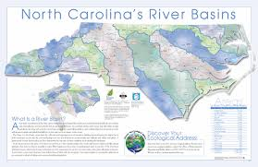
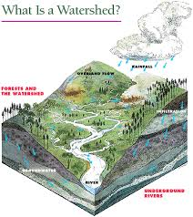
Watersheds
Watersheds are areas of land that drain into a stream, river, lake, or other body of water.
River Basins are the land that water flows across or under on its way to a river

Slide 20
North Carolina’s Water
The Neuse River
Begins in Orange and Person counties
Flows 400 kilometers (250 miles) to the Pamlico Sound
Pamlico Sound is an estuary
A body of water in which freshwater from a river meets and mixes with salt water from the ocean
The Pamlico Sound is also fed by Tar-Pamlico River Basin

Slide 21
Additional Videos
Water - Liquid Awesome: Crash Course Biology #2
11:16 minutes
How Stuff Works- Water
35:12 minutes

