Slide 1
Biotechnology

Slide 2
What is Biotechnology
Manipulation of living things to make useful products
Uses organisms to solve real world problems
Used to domesticate animals and plants
Creates safer food sources

Slide 3
What is Biotechnology
More recently:
Alters genes of organisms
Cleans up waste
Generates cheaper food
Creates fuel sources
Also used in forensics, medicine, agriculture and food processing

Slide 4
Human Genome Project
Gene
The basic physical unit of heredity
Genetics
The science of heredity, dealing with resemblances and differences of related organisms resulting from the interaction of their genes and the environment
Genetic Modification
Any alteration of genetic material, as in agriculture, to make the capable of producing new substances or performing new functions

Slide 5
Human Genome Project
The study of an organism’s entire genome, including DNA sequencing
Used to study how the body works
Used to understand how each body is unique
Genomics
The use of a patient’s genome to select treatment that is suited to a patient’s individual genes
The goal is to develop medicine unique to an individual.
Personalized Medicine

Slide 6
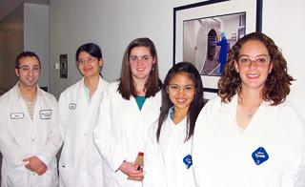
Careers in Biotechnology
Bioengineers
Apply engineering principles to living systems.
Create products that meet human needs.
Sciences included
Microbiology
Computer Technology
Robotics
Molecular Biology
Biochemistry
Pharmacology
Immunology
Explore Careers

Slide 7
Biotechnology in Forensics
Forensic Science
Branch of study associated with the legal system
Uses physical evidence
Fingerprints
Bullet casings
Blood splatter
Uses biotechnology
Blood typing
DNA analysis

Slide 8
Biotechnology in Forensics
You are NOT the father!
Scientists use blood type information to establish a child's biological parent.
Humans have four blood types:
A, AB, B, and O
Different blood types can not match up together such as a child with blood type O can not have a mother with blood type AB

Slide 9
Biotechnology in Forensics
DNA Analysis takes a specific portion of a persons DNA and uses laboratory techniques to examine it more closely
This is a more accurate way to prove who a parent is.
Once the DNA of a child is mapped, they compare it to the suspected parent to find similarities.
This is also used in criminal cases to locate suspects.
DNA analysis cannot be used to find a criminal, there must be a sample to compare to the collected DNA.

Slide 10
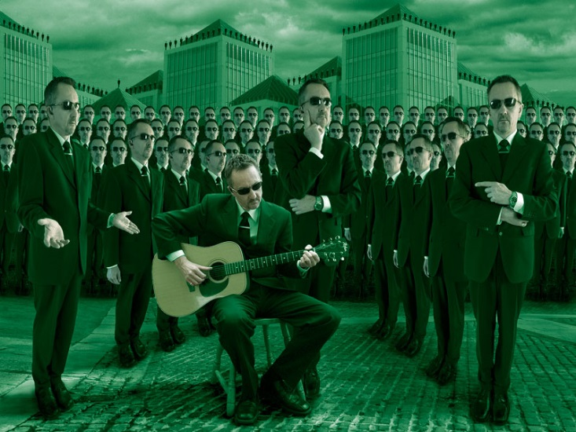
Biotechnology in Medicine
The medical industry has many uses
Genetic testing
Gene therapy
Cloning
Tissue culturing
Development of better drugs

Slide 11
Biotechnology in Medicine
Genetic Testing
Takes a DNA sample and breaks it apart
Human Genome Project
Mapping the human genome
Used to screen for diseases
Breast Cancer is an example
Gene Therapy
Utilizes viruses or bacteria to enter a cell and replace defective genes
Believed to be the best way to cure diseases once they have been identified

Slide 13
Biotechnology in Medicine
Cloning
Creation of genetically identical organisms
Many organisms have be cloned
“Dolly the sheep” is the most famous
Examples of cloning
Tissue Culturing
Allows bioengineers to grow human tissues and organs in the laboratory
Human ears, livers and heart cells have been grown
Hoped to be used in organ transplants

Slide 15
Biotechnology in Medicine
Drug Development
process of bringing a new drug to the market once a lead compound has been identified.
One example is bioengineered bacteria used to treat diabetes
Gene used to produce insulin is inserted into bacteria cells.
The bacteria reproduces quickly producing large amounts of insulin
Also used to create cheaper antibiotics

Slide 16
Biotechnology in Microbiology
Microbiology
Field of science that studies microbes
Microbes can work for and against humans
Bacteria in our intestines absorb vitamins and minerals
Bacteria in soil help plants trap nitrogen for growth
Microbes are natures garbage men
Process waste
Recycle matter

Slide 17
Biotechnology in Microbiology
Bioremediation
Uses microbes to remove harmful toxins from the environment
Toxic
Acting as, or having the effect of, a poison
Gulf Coast Oil Spill
Bioremediation Explanation

Slide 18
Biotechnology in Microbiology
Used in sewage treatment plants
Harmful chemicals have been used in the past
These have been replaced with microbes
They do the job faster
Cheaper
Do not leave behind harmful pollutants
Now being used in household cleaners
Breakdown in sunlight

Slide 19
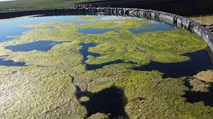
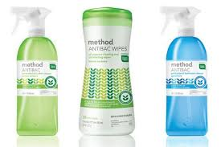
Sewage treatment plant, microbes are cleaning the waste

Slide 20
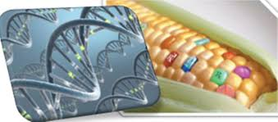
Biotechnology in Agriculture
Oldest form of biotechnology
Uses artificial (not natural) selection
Increasing yields
Decreases crop stress
Produces food quality
Also used with animals
Produces more milk, meat, or wool
Does so quicker than ever before
Click Above For Video

Slide 21
Biotechnology in Agriculture
Organisms that have genes from a different species artificially inserted into their genome.
Plants can be altered to grow more quickly, flower earlier, produce more flowers, and even grow more fruit
Transgenic Crops
Insecticides
Chemicals that kill insects
Insect Resistant Crops
Crops modified to produce their own insecticides
Bt Corn
Specific example of insect resistant crop
Bacillus thuringiensis
Bt Corn Video

Slide 22
Reducing Environmental Stressors
Scientists have noticed that weeds grow in harsh conditions and environments
The genes are inserted into transgenic crops
Tomatoes, corn, wheat, rice, or barley
This allows domestic crops to grow in harsh conditions and even survive droughts

Slide 23
Improving Food Quality
This is an important goal of biotechnology
Scientists can control
Size
Taste
Amount of nutrients
When it ripens
How long it stays fresh
All this helps control costs and allows people to become healthier while reducing disease.

Slide 24
Improving Food Quality
Golden Rice
An example of a crop that has been genetically modified to improve its quality
Makes beta-carotene in its grains
Beta-carotene is needed to make vitamin A
Developed to stop malnutrition in Africa and Southeast Asia
Children in these areas regularly ate food with too little vitamin A
Too little vitamin A can cause disease, illness, blindness, and even death

Slide 25
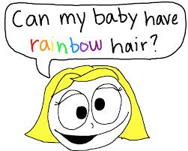
Ethical Issues in Biotechnology
Fear of impact of modified crops
Unforeseen consequences
Cross pollinate with wild plants
Harm to people with food allergies
Body reactions to new crops/foods
Can they cause diseases?
Ethical questions
Dealing with morals, deciding what is right and wrong in conduct
Is it a good idea?
Human Genome project
Who owns the information?
Who gets to decide what is a good/bad use?
Can we alter the gene to produce specific results?
Design your own baby?

Slide 26
Biotechnology in North Carolina
Research Triangle
Raleigh/Durham/Chapel Hill
Cutting edge research at local Universities attracts many companies that perform tech research and biotech research.
Creates jobs in North Carolina
Largest research park in the United States

Slide 27
