Slide 1
Cell Structures and Processes
SUMMARIZE HOW FOOD PROVIDES THE ENERGY AND THE MOLECULES REQUIRED FOR BUILDING MATERIALS, GROWTH AND SURVIVAL OF ALL ORGANISMS (TO INCLUDE PLANTS)

Slide 2
Cells
Organisms
Living things
Everything is made up of cells
Some have just one cell
Others are made up of trillions
Like humans

Slide 3
Cells
Cells
Basic unit of structure and function in all organisms.
Smallest structure that can carry out the functions of life
Growing
Taking in and using food
Responding to the environment
Reproducing
Also regulate the amount of water they contain and release waste
Cell vs Virus Video

Slide 4
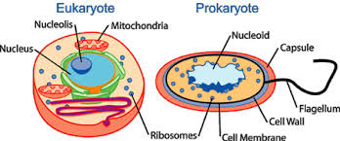
Prokaryotic and Eukaryotic Cells
Two basic types
Prokaryote
Eukaryote

Slide 5
Prokaryotic and Eukaryotic Cells
Prokaryote
Organisms whose cell lack a nucleus and membrane bound organelles.
Simpler than the Eukaryote
Has ribosomes, but no membranes surrounding them.
Most life processes happen in the cytoplasm
Fluid that fills most of the space in the cell
Most are single cells
Includes: Bacteria

Slide 6
Prokaryotic and Eukaryotic Cells
Eukaryote
Organism whose cells have a nucleus and Organelles
Structure that carries out a certain function
Larger than prokaryote
Has a nucleus
Includes:
Plants, animals, protists, and fungi
Usually a large number of cells working together
Has ribosomes with membranes surrounding them

Slide 7
Structures of Eukaryotic Cells
Structures are located inside the cytoplasm
Nucleus
Large structure inside the cell that controls many functions in the cell
Contains the cells genetic material
Chromosomes
Genetic material organized into structures
Cell membrane
Thin, flexible outer layer that holds the cell together and controls what enters and leaves
Ribosomes
Cell structures that make proteins

Slide 8
Structures of Eukaryotic Cells
All cells need energy
Mitochondria (Mitochondrion -singular)
Release the energy stored in glucose
They take in fuel and change it to energy
Vacuoles
Store materials inside the cell
Water, salts, proteins, & carbohydrates
Animal cells have small vacuoles
Plant cells have large vacuoles
Help support structure of the cell

Slide 9
Structures of Eukaryotic Cells
Plant cells have two things animal cells do not:
Chloroplasts
Organelles that make food for cells
Contain chlorophyll which makes the plants green
Converts CO2 and H2O into Glucose and O2
Cell Walls
Protective layer that surrounds the cell membrane
Made of cellulose
Rigid to support plant cells
Allows plants to stand upright and support flowers and leaves

Slide 10
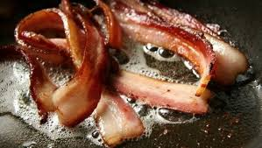
Energy and Matter for Cells
All living things need food
Provides organisms with what is needed to grow and repair
Some organisms make their own food
Proteins
plant or animal tissue rich in molecules, a food source supplying amino acids to the body

Slide 11
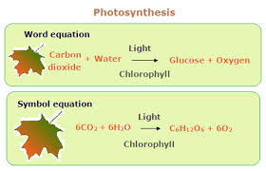
Photosynthesis
Photosynthesis
Process in which the cells of plants and other organisms use the energy of sunlight to make food.
Used to make glucose
A major energy source in metabolism

Slide 12
Cellular Respiration
Cellular Respiration
The process by which cells break down sugar to release stored energy.
It is the opposite of photosynthesis
Oxygen taken in by air we breathe
Some energy turned into thermal energy to keep body warm

Slide 13
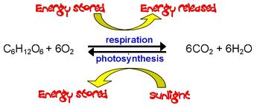
Click pictures below for video.
Another video…

Slide 14
Building Cells
Nutrients
The compounds that provide energy and building materials for living things
Sugars
Provide living things with energy and act as substances used for structure
Another name for Carbohydrates
ATP (Adenosine Triphosphate)
Serve as a source of energy for reactions such as muscle contraction
When sugars are broken down they can power cell machinery to create the energy-rich compound called ATP

Slide 15
Building Cells
Carbohydrates
Hydrogen, oxygen, and carbon
Includes glucose made during photosynthesis
Plants use and store glucose
Molecules link together to form cellulose
Cellulose used for plant structure and is important food for plants and animals
What gives vegetables their crunch.

Slide 16
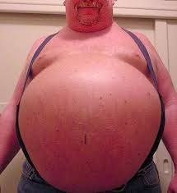
Building Cells
Lipids
Fats
Solid at room temperature
Oils
Liquid at room temperature
Second choice for energy
Produce oils that keep hair, skin, and feathers smooth and waterproof
Animals store energy as fats
Found under layers of skin to keep animals warm

Slide 17
Cell Division and Reproduction
Reproduce
Make more cells like themselves
They do this by dividing
There are two types
Asexual
Mitosis
Sexual
Meiosis

Slide 18
Chromosomes and Cell Division
Chromosomes
Structures in a cells nucleus that contain genes
Gene
Tiny part of a chromosome that gives a living thing a certain trait
Tell a cell how to grow and develop
DNA
Large molecules that make up genes
Deoxyribonucleic acid

Slide 19
Chromosomes and Cell Division
Mitosis
Parent cell divides to form two new cells called daughter cells
Each is an exact copy of the parent
Before dividing the cell makes exact copies of the chromosomes
Each daughter has the same number and kind of chromosomes as the parent
This occurs in 4 stages

Slide 20
Chromosomes and Cell Division
Four stages of mitosis
Prophase
Chromosomes cannot be seen
Metaphase
Chromosomes are lined up in the center
Anaphase
Chromatids are pulled apart
Telophase
Chromosomes separate and a nucleus is formed

Slide 21
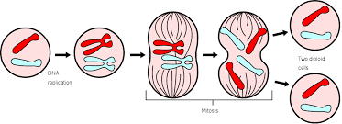
Chromosomes and Cell Division

Slide 22
Chromosomes and Cell Division
This is process by which living things grow
Muscles
Plant roots
Flowers
Process by which bodies repair themselves
Cuts in your skin
Limb regeneration in some animals

Slide 23
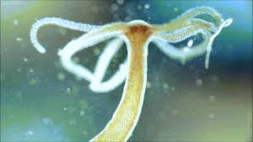
Asexual Reproduction
Asexual Reproduction
Production of a new organism from one parent
One celled organisms reproduce this way
Bacteria
Amoebas
Some animals do as well
Hydras

Slide 24
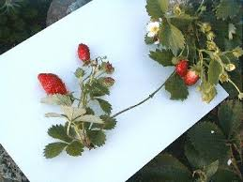
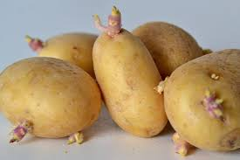
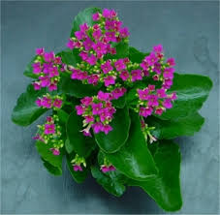
Asexual Reproduction
Also occurs in some plants
Strawberries
Potatoes
Kalanchoes

Slide 25
Sexual Reproduction and Meiosis
Sexual reproduction
Production of new organisms from two parents, male and female
Organisms use gametes for this process
Only have half the number of chromosomes found in the other body cells
Two types
Sperm
Egg

Slide 26
Sexual Reproduction and Meiosis
Fertilization
Male and female gametes combine
Zygote
The resulting cell from fertilization
It is important that each cell only have half the chromosomes to make up the fertilized cell
Meiosis
The process that produces gametes

Slide 27
Sexual Reproduction and Meiosis
Involves two sets of divisions
First division
Pairs separate
Second division
Copies separate
One cell produces four gametes
Each has half the chromosomes of the parent

Slide 28
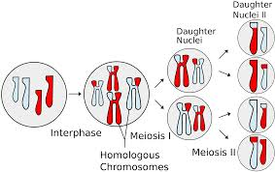
Sexual Reproduction and Meiosis

Slide 29
Sexual Reproduction and Meiosis
In a male it produces sperm cells
In a female it produces egg cells
A single sperm joins with a single egg to produce a fertilized egg (zygote)
Zygote has a complete set of chromosomes
Mitosis is then used to grow and develop into a complete organism.
Video not available…

