Slide 1
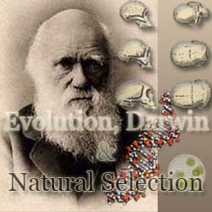

Slide 2
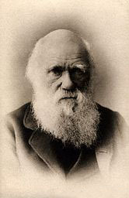
Charles Darwin (1809-1882) Sailed around the world 1831-1836
Darwin Video

Slide 3
What did Darwin’s Travels reveal
The diversity of living species was far greater than anyone had previously known!!
These observations led him to develop the Theory of Evolution!!

Slide 4
How did tortoises and birds differ among the islands of the Galapagos?
Each island had its own type of tortoises and birds that were clearly different from other islands

Slide 5
Galapagos Turtles

Slide 6
The Theory of Evolution is when organisms change over time. So, modern organisms descended from ancient ones

Slide 7
Evolution is a Theory – Just like Gravity!
Evolution is a well supported explanation of phenomena that have occurred in the natural world
A theory in science is a well tested hypothesis, not just a guess
7 MYTHS You Still Believe About EVOLUTION
(Trust me, its worth it…)

Slide 8
Previous Theory by Lamarck Theory of acquired characteristics
Jean-Baptiste Lamarck said organisms acquired traits by using their bodies in new ways
These new characteristics were passed to offspring
Lamarck was totally wrong!
Lamarck vs. Darwin

Slide 9
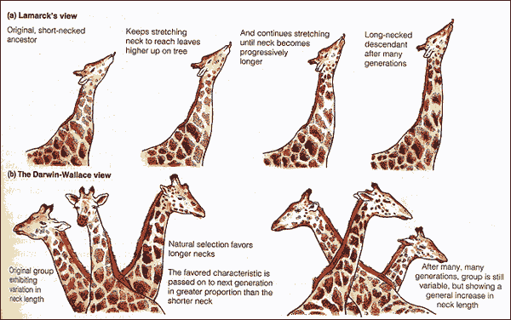

Slide 10
Darwin finally published his ideas in 1859
Other naturalists were developing the same theory that Darwin did.
Even though he was afraid of the Church’s reaction to his book he wanted to get credit for his work.

Slide 11
Vocabulary
Biological Evolution
Any genetic change in a population that is inherited over several generations
Phenotype
The set of observable characteristics of an individual resulting from the interaction of its genotype with the environment (body structures and characteristics)
Genotype
The genetic makeup of an individual organism

Slide 12
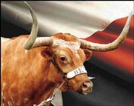
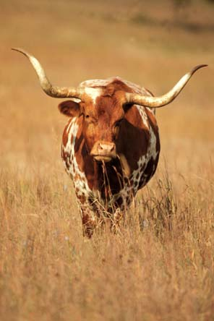
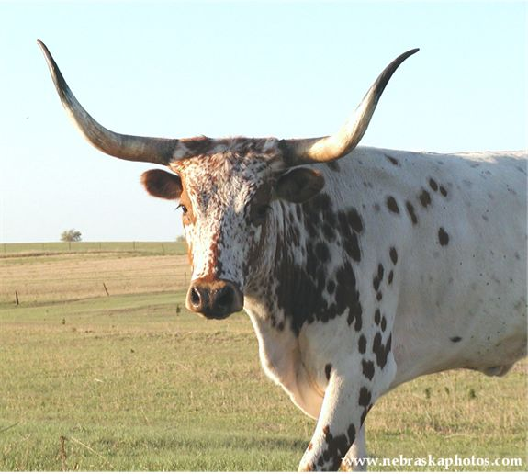
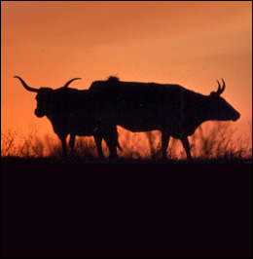
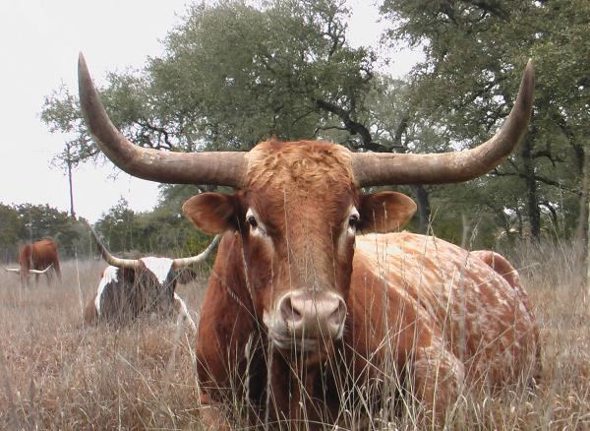
Artificial Selection
Intentional breeding of plants and animals to preserve traits that breeders want.
a farmer breeds only his best livestock
A farmer plants only seed from crops that have bountiful yields

Slide 13
Natural Selection
The process where organisms better adapted to their environment tend to survive longer and produce more offspring
Darwin’s Proof

Slide 17
Natural Selection and Biological Fitness
The genetic contribution of an individual to the next generations gene pool.
Overtime, natural selection results in changes in the inherited characteristics of a population.
These changes increase a species fitness (survival rate)

Slide 18
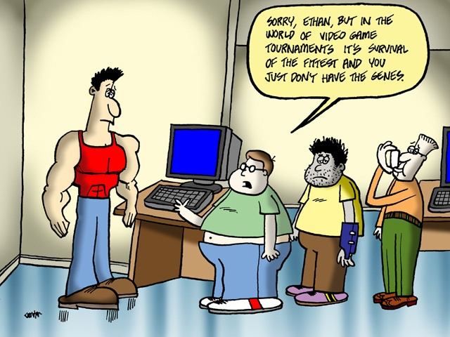
Survival of the Fittest
populations with the most desirable traits and ability to compete will live long enough to reproduce and pass on those beneficial traits.

Slide 19
6 key points
Overproduction:
living things produce more offspring than needed for the species to survive
Populations remain constant because only a small fraction live long enough to reproduce (food is a limiting factor)

Slide 20
6 key points
Competition:
struggle between organisms for food, shelter, mates and living space
Resources for life are limited so an organisms must compete within its species and with other species to survive long enough to reproduce

Slide 21
6 key points
Variation:
Exists in the phenotypes of the individuals within every population
differences (structural, molecular, and behavioral) within a species that makes individuals different
An organism’s phenotype may influence its ability to find, obtain, or utilize its resources (food, water, shelter, etc) and may affect its ability to reproduce

Slide 22
6 key points
Adaptation:
inherited traits that improve an organisms chances of survival and reproduction in a certain environment “ Survival of the Fittest!”
Individuals that are better adapted to the environment will live long enough to reproduce
Camouflage or blending coloring

Slide 23
6 key points
Reproduction:
Individuals that have favorable traits and better adapted to survive will pass on these traits to future offspring
Good genes survive and bad ones are eliminated

Slide 24
6 key points
Speciation:
A new species is formed over many generations of favorable adaptations gradually accumulate and non-favorable ones disappear.
So many gradual changes accumulate that a new species emerges

Slide 25
Camouflage
Blends into the environment

Slide 26
Warning Coloration
Shows a predator (or prey) that they are unpleasant to eat.

Slide 27
Mimicry
Resembles another species to gain an advantage at survival

Slide 28
Speciation
Favorable adaptations accumulate
To the advantage of someone or something
Unfavorable disappear
All changes may eventually result in a new species

Slide 29
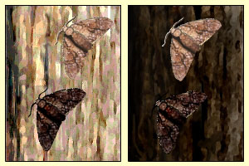
Mutations
Source of Genetic Variations
Diversity in gene frequencies between individuals or populations
May be harmful or helpful
The mutation could turn a harmful allele into a helpful trait

Slide 30
Summary of Darwin’s Theory
1. Organisms differ; variation is inherited
2. Organisms produce more offspring than survive
3. Organisms compete for resources
4. Organisms with advantages survive to pass those advantages to their children
5. Species alive today are descended with modifications from common ancestors

Slide 31
Evidence of Evolution
1. Fossil Record
Law of Superposition
Theory of Plate Tectonics
Geographic Distribution of Living Species
Geological Evolution
Science that deals with the physical history of the Earth and the changes it is and has undergone.
Comparative Anatomy
The branch of Science concerned with the bodily structures of humans, animals, and other living organisms.
Homologous structures
Analogous structures
Vestigial structures
4. Similarities in Embryology

