Slide 1
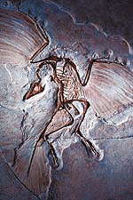
Evidence of Evolution – Fossil Record
Fossil Record provides evidence that living things have evolved
Fossils show the history of life on earth and how different groups of organisms have changed over time
Transitional Fossils –
any fossil which gives us information about a transition from one species to another; helps support the Theory of Evolution

Slide 2
Primate Fossils
Australopithecus Homo erectus Homo sapien

Slide 3
Primate Brain Capacity

Slide 4
Primate Bone structure

Slide 5
Homo habilis = handy human 1.5 to 2 mya
Homo erectus 1.6 mya
bipedal

Slide 6
Cro-Magnon
35,000 to 40,000 ya
Neanderthals
35,000 to 100,000 ya
Notes:
http://www.culture.gouv.fr/culture/arcnat/chauvet/en/

Slide 7
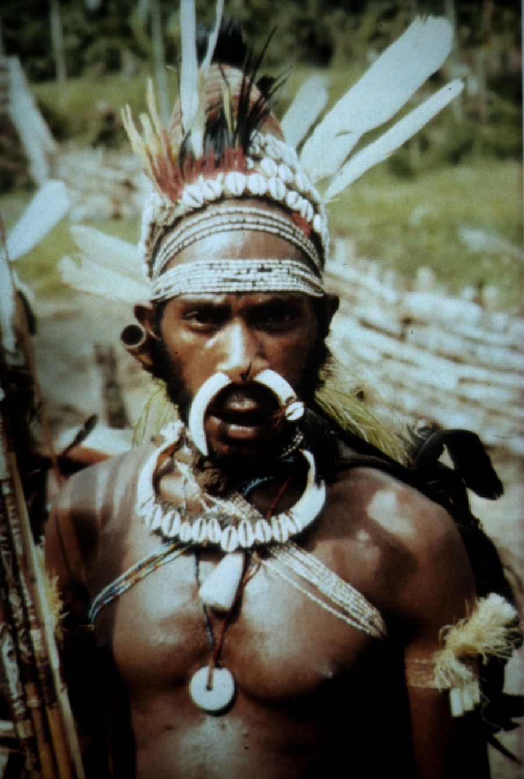
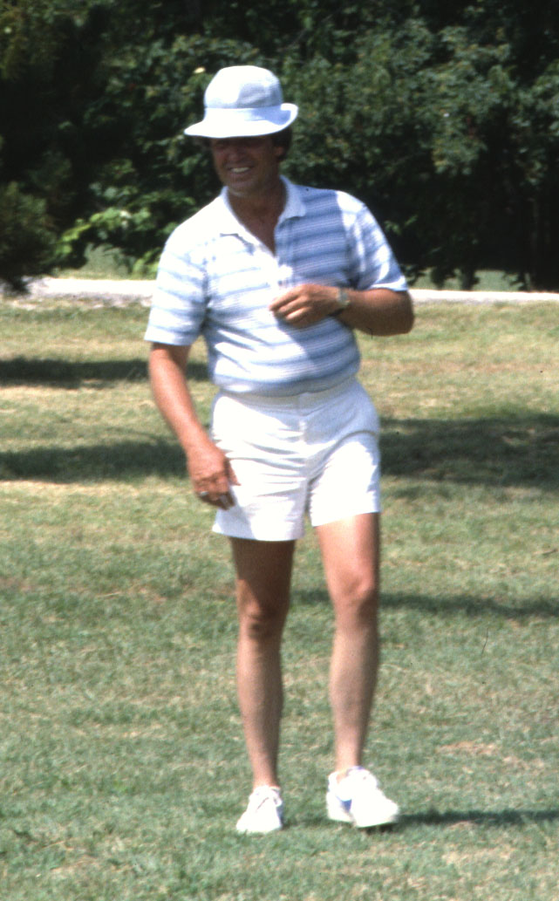
Modern Homo sapien
(fully modern fossils 100,000 ya)

Slide 8
Evidence of Evolution – Geologic Evolution
Theory of Plate Tectonics
A theory that states that the earth’s crust is made up of a number of plates which move over a liquid crust that get created and destroyed over time.
Video

Slide 9
Evidence of Evolution – Geologic Evolution
Pangea
Two hundred million years ago (Mya), research suggests that all the continents were one large mass.
Terrestrial organisms were able to migrate across all the continents and were only limited by their biotic potential.

Slide 10
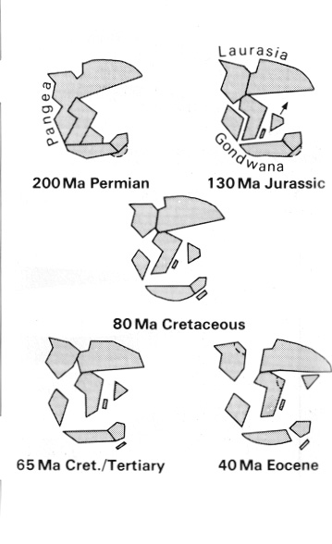

Slide 11
Evidence of Evolution – Geologic Evolution Relative vs. Absolute Dating

Slide 12
Biodiversity
The variety of life in the world, or in a specific habitat or ecosystem
Pangea began to separate into separate continents creating physical barriers such as seas, restricting migration to within the continents.
Gene pools of species are separated and as they are exposed to different biotic and abiotic conditions, each portion of the species adapts differently and eventually forms new species on the separated continents.
This process is known as speciation.

Slide 13
Biodiversity
Changes in abiotic and biotic conditions will also lead to the creation of new species increasing the diversity of habitats and niches.
This also provides the space for new species to evolve into these habitats.
The end result of the separation of Pangea into today’s continental configuration is that plate tectonics has been one of the main driving forces promoting biodiversity of organisms.

Slide 14
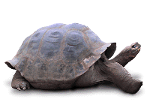
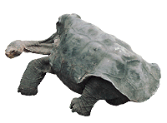
Evidence of Evolution
Geographic Distribution of Living Species
Similar animals in different locations were the product of different lines of descent

Slide 16
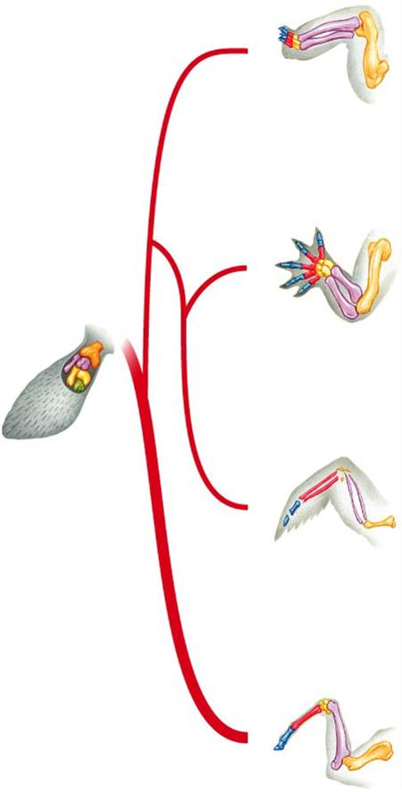
Evidence for Evolution – Comparative Anatomy
Turtle
Homologous Body Structures
Structures that have different mature forms but develop from the same embryonic tissues
e.g. Wing of bat, human arm, leg of turtle
Alligator
Bird

Slide 17
Homologous Body Structures

Slide 18
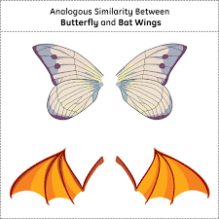
Evidence for Evolution – Comparative Anatomy
Analogous Structures
Structures in different species that have similar appearance or function but have evolved separately thus do not share a common ancestor
Similar functions, but different internal structures
Similarities:
birds and insects wings both are used for flying
Differences:
internal structures and embryo development are very different
Picture from: http://en.wikipedia.org/wiki/Analogy_(biology)

Slide 19
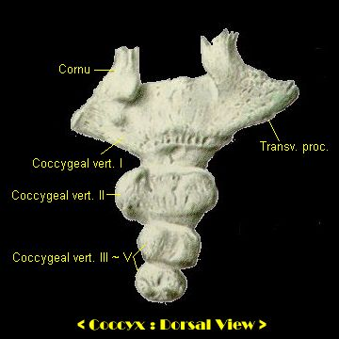
Evidence for Evolution – Comparative Anatomy
Vestigial Structures
Remnants of structures that were once functional in an ancestor (now-reduced in size and serve little or no function

Slide 20
Vestigial structures in Pythons
Have hind leg bones and non-functional legs

Slide 21
Examples:
Tail bone: (coccyx) remnant of a reptilian tail
Wisdom teeth
Muscles that move nose and ears
Whales and snakes have hind leg bones imbedded in their bodies from four legged ancestors

Slide 22
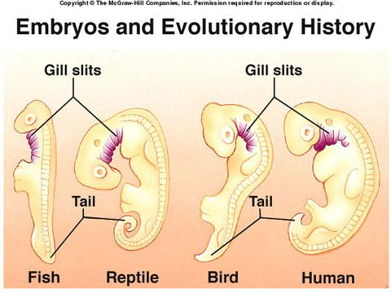
Evidence of Evolution – Similarities in Embryology
Embryology
A branch of biology that studies early life stages and their development
In their early stages of development, chickens, turtles and rats look similar, providing evidence that they shared a common ancestor.

Slide 23
Embryological development

